Slide 1

Welcome
Notes:
Topic: Emotional Intelligence (EQ)
Time: 30 minutes
Purpose of training evolution: Sailors will enhance EQ for better self-regulation and stronger interpersonal relationships.
Expected outcome of training evolution: Sailors will learn emotional regulation techniques to enhance EQ and practice interpersonal communication skills to improve social interactions.
Safety: Inform Sailors of safety hazards in the training environment. For some topics, Sailors should be informed if there is a designated person to talk to if the Sailor feels compelled to leave the training.
Facilitator Actions:
Display slide.
Greet Sailors.
Introduce yourself and give any background on yourself that might be of interest.
Establish credibility.
Facilitator Instructions:
The slide deck acts as a guide to present a facilitated discussion that may include activities.
Best practice: Use the slide to develop interest in the subject matter. Do not read the slides word for word. The Sailors should be able read the text and understand the messaging presented in the graphics.
Facilitator notes are available for each slide to help the Facilitator deliver the topic.
Best practice: Use the Slide Show view to ensure the Facilitator notes are viewable.
The Facilitator notes are divided into general instructions for Facilitator Actions (mechanics of facilitation) and the Facilitator Content (Inform, Discuss, Perform, and Reference).
Best practice for Inform: Present facts, concepts, and procedures. Depending on the facilitator’s expertise, content may be used as background information or suggested talking points. Content in quotation marks is recommended to be read verbatim.
Best practice for Discuss: Conduct large-group question and answer sessions or large-group, Facilitator-led activities. Depending on the subject matter, these may be written as questions with expected answers or scripted activities.
Best practice for Perform: Facilitate small-group, scenario-based or procedural activities. Depending on the subject matter, these may be written with specific actions the Sailors will take or general ways for the Facilitator to monitor the activities. The Facilitator will be provided with expected outcomes to ensure Sailors leave training with correct information.
Best practice for Reference: This is for Facilitator use only.

Slide 2
Introduction
Warrior Toughness
MIND • BODY • SPIRIT
Emotional Intelligence (EQ)
Notes:
Facilitator Actions:
Display slide.
Introduce topic.
Let Sailors know that they can leave the discussion if they have to for their own well-being.
Ensure that misinformation is corrected immediately.
Monitor the discussions of the Sailors throughout the training event.
Facilitator Content:
To build Warrior Toughness, Sailors will explore Warrior Toughness and the Warrior Mindset and participate in discussions to enable Sailors to develop their why (warrior ethos).

Slide 3
Learning Objective
Use EQ to manage your own emotions and understand the emotions of others to build a winning team.
Notes:
Facilitator Actions:
Display slide.
Neither Sailors nor Facilitator should read the objective out loud.
Facilitator Content: N/A

Slide 4

EQ
Notes:
Facilitator Actions:
Display slide.
Discuss how graphic relates to topic.
Monitor the discussions of the Sailors.
Facilitator Content:
Inform:
EQ refers to the nature and characteristics of an individual's emotional experiences, including the intensity, range, and impact on behavior and interactions.
EQ is:
The ability to recognize, understand, and manage your own emotions that drive your behaviors and impact others
The ability to recognize, understand, and influence the emotions of others
The five components of EQ are:
Self-awareness: understanding your emotions and their impact on your thoughts and behavior
Self-regulation: managing your emotions in healthy ways
Motivation: using emotional energy to pursue goals with determination and focus
Empathy: understanding and recognizing emotions in others
Social skills: managing relationships and building rapport with others

Slide 5

Purpose of Emotions
Learn to use your emotions to think, not think with your emotions.
– Robert T. Kiyosaki, author of Rich Dad, Poor Dad
Notes:
Facilitator Actions:
Display slide.
Discuss how graphic relates to topic.
Monitor the discussions of the Sailors.
Facilitator Content:
Inform:
Each emotion has an appearance that can affect how other people behave, making them useful instruments for communication.
Our emotions have the power to guide our actions in ways that will help us survive.
We must be connected to all our emotions, even the negative ones, to be healthy and productive.
You can react more skillfully if you can recognize the emotion you are feeling and what it is telling you.
The Warrior Mindset requires focus and performance under stress. EQ is a part of the entire cycle of the Warrior Mindset because emotions are a part of everything.
Reference:
https://www.azquotes.com/quote/921703

Slide 6
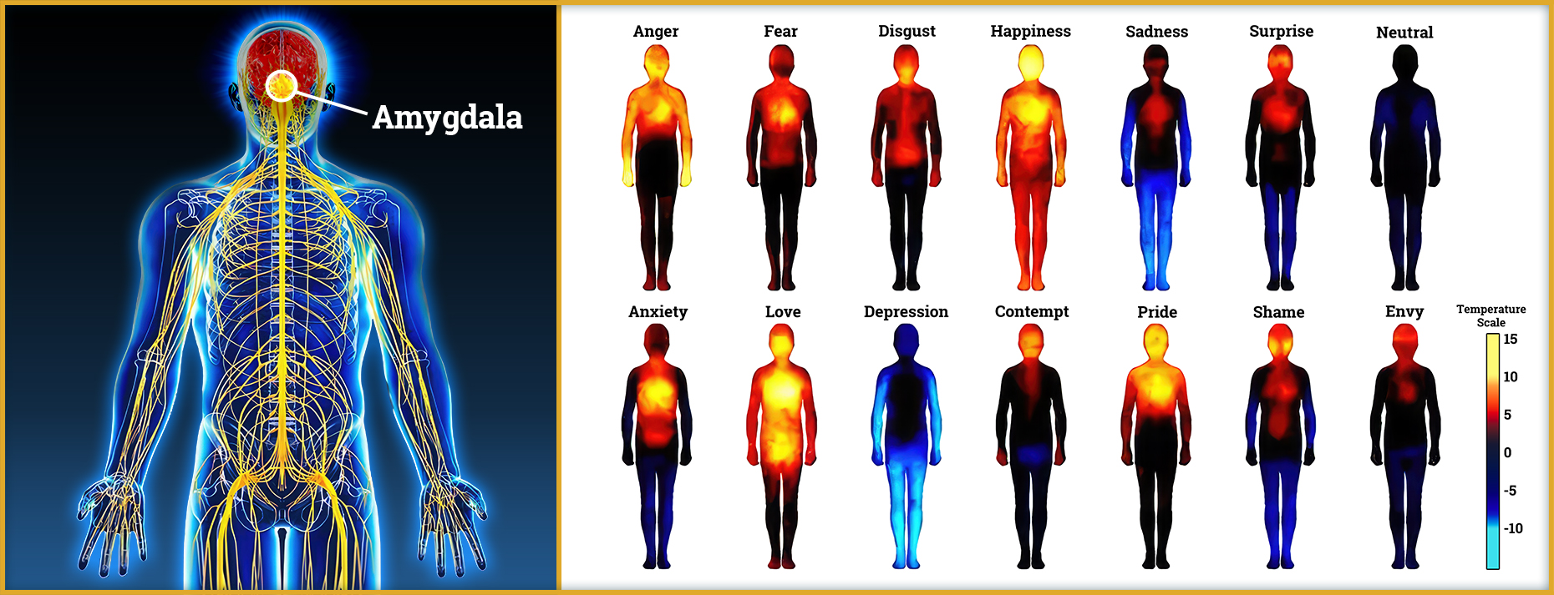
Physical Impacts of Emotion
Can you physically feel emotions?
Notes:
Facilitator Actions:
Display slide.
Discuss how graphics relate to topic.
Monitor the discussions of the Sailors.
Facilitator Content:
Discuss:
Can you physically feel emotions? (Answer: Yes! Sailors may not answer correctly; however, this question is to probe current understanding and allows them to start making connections.)
Inform:
Our physical, mental, and emotional states are all interconnected and have an impact on each other.
Essentially, emotions are not limited to the mind; they can also have immediate and significant impacts on the body, and the body's reactions to emotions can also have an impact on mental states.
This interdependence emphasizes how crucial it is to manage one's physical and mental health in order to maintain total well-being.
Every time you feel an emotion, information is sent from the amygdala that can have certain effects on your body.
Anger raises body temperature, frequently causing an internal heating sensation. This is because anger causes adrenaline to be released, which increases blood flow and heart rate and warms the body.
Fear causes body temperature to drop, especially in the hands and feet. Fear causes the skin to feel clammy and cold by rerouting blood to the core organs in anticipation of the fight or flight reaction.
Disgust reduces body temperature a little, especially in the face. A feeling of cold can result from disgust rerouting blood flow away from the skin.
Happiness may cause a little rise in body temperature, giving one a cozy feeling. Happiness and other positive emotions encourage relaxation and improved blood flow, which produces a soft warmth.
Sadness reduces body warmth. Sadness can cause a chilling effect, especially in the extremities, by slowing down physiological functions and lowering blood circulation.
Surprise causes a brief spike in body temperature because of the adrenaline rush that comes with unforeseen circumstances. The body warms when blood flow and heart rate momentarily increase.
Shame quickly raises the temperature of the face, which frequently results in blushing. This happens as a result of shame causing the facial blood vessels to dilate, boosting blood flow and producing warmth in the neck and cheeks.
Anxiety can cause body temperature to rise or fall. In response, the body may produce sweat, which cools the body, and release adrenaline, which may warm the center while keeping the extremities frigid.
Love can raise body temperature by causing similar physiological reactions to happiness, such as an increase in heart rate and blood flow, which can provide warmth and comfort.

Slide 7
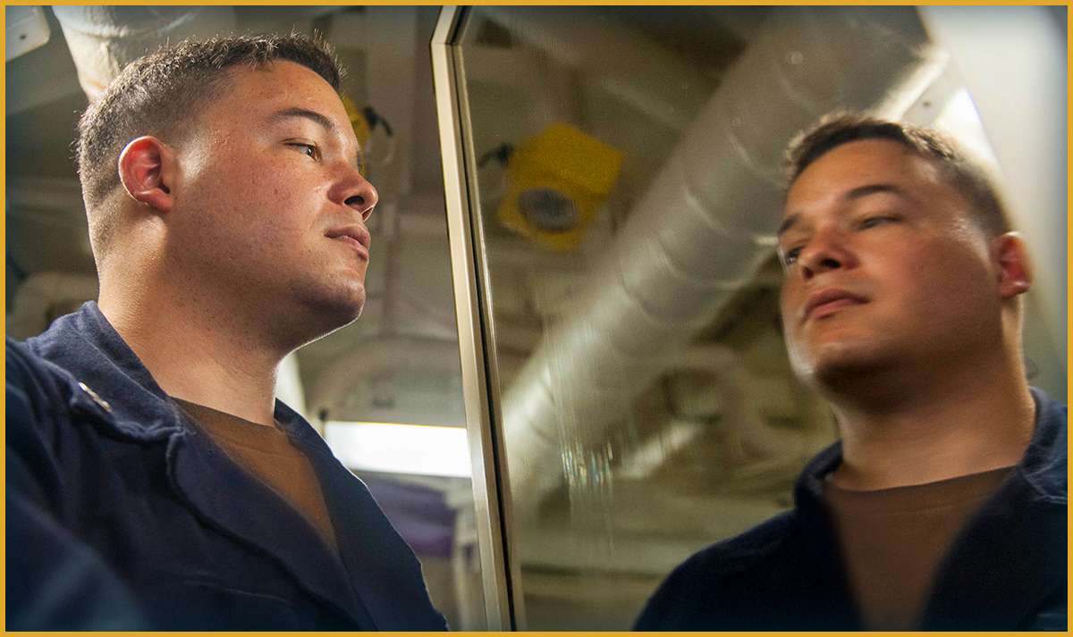
Self-Awareness
When you are self-aware, you have a clear understanding of your own strengths and weaknesses and perceive yourself as others do.
Notes:
Facilitator Actions:
Display slide.
Discuss how graphic relates to topic.
Monitor the discussions of the Sailors.
Facilitator Content:
Inform:
Self-awareness is the ability to detect and comprehend your moods, feelings, and motivations, as well as their impact on others.
Self-confidence stems from a positive self-perception and belief in one's abilities to handle situations and challenges. It is rooted in knowing what you are capable of and trusting that you can navigate difficulties.
In order to conduct a realistic self-evaluation, you must honestly evaluate and accept your limitations while also recognizing your internal resources, skills, and capabilities.
Self-awareness builds toughness and reinforces resilience. Responding versus reacting, through self-regulation, will increase your ability and your shipmate's ability to embrace adversity and achieve success through sound decision-making and team connectedness.
Reflecting and learning to become comfortable with your own emotions and their driving factors is key to personal growth and your growth as a member of a team and a leader.
Some self-assessment questions you can ask yourself might include:
Can I tell what I’m feeling right now?
Do I notice how my mood affects the people around me?
Can I admit when something is hard for me?
Am I willing to listen when someone gives me feedback?
Can I stay calm when things don’t go as planned?

Slide 8

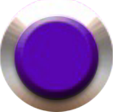
Self-Regulation
Why do you think emotional control is crucial in high-pressure work environments?
Emotional Expression
Emotional Suppression
Immediate and uncontrolled
Passionate
Amygdala driven
Containing
Hiding
Pretending
Reappraisal
Expression
Suppression
Emotional Reappraisal
Cognitive reframing of an event to adaptively mitigate emotions relative to the situation
Using the frontal cortex
Strategically utilizing EQ to maximize performance
Notes:
Facilitator Actions:
Display slide.
Discuss how graphic relates to topic.
Monitor the discussions of the Sailors.
Facilitator Content:
Inform:
Emotions are felt and expressed in varying intensities, either openly or suppressed.
Emotion is information. How we use the information determines whether it is useful or not.
Emotional regulation is the ability to exert control over one’s own emotional state.
Discuss:
Why is it important to control your emotions in high-pressure situations? (Answer: Staying calm helps you think clearly, avoid conflict, and lead others effectively.)
Inform:
The most typical method we deal with our emotions is through suppression.
It entails keeping our feelings to ourselves or acting as though we are not distressed.
When we say suppression, it is not complete suppression. That can be a problem, but there are times when we have to during a critical event. Can anyone think when this would be beneficial?
Expression is nearly the opposite of suppression.
It is spontaneous, illogical, and uncontrollable emotional outbursts.
There are some situations where this would be necessary.
Discuss:
When might it be helpful to show strong emotions right away? (Answer: When taking the initiative to respond to urgent safety concerns, such as yelling at someone who is about to act in a way that could endanger others)
When might it be better to hold back your emotions? (Answer: In an emergency where you need to stay focused and follow your training)
Inform:
Emotional regulation or reappraisal involves concepts like cognitive reframing, that is rethinking a challenging situation to reduce anger or anxiety, hiding visible signs of sadness or fear, or focusing on reasons to feel happy or calm (i.e., feeling anger because "Everyone is out to get me" and reframing to "My team needs the best from me," as well as viewing a threat versus a challenge).
Reappraisal is the best method for dealing with emotions.
With the help of emotional reappraisal, you may maximize your performance by using the information that emotions provide.
Because it will raise your EQ, being able to recognize and reevaluate your emotions will also make you more resilient.
You might also ask yourself if what your emotions are telling you is beneficial or detrimental.
To reduce the detrimental effects of emotions, reappraisal entails:
Adopting a new perspective on the incident
Using cognitive flexibility
Restraining or refocusing erratic moods and impulses
Considering words and actions before taking them
Acquiring a degree of comfort so you can cope with ambiguity, uncertainty, and lack of clarity
Practicing deep breathing
Using sensory grounding
Utilizing Mindfulness
Discuss:
How can changing the way you look at a situation (reappraisal) help you manage your emotions and perform better under pressure? (Answers include: pausing and not reacting emotionally, focusing on finding solutions, handling tough situations more calmly, staying present in the moment)

Slide 9
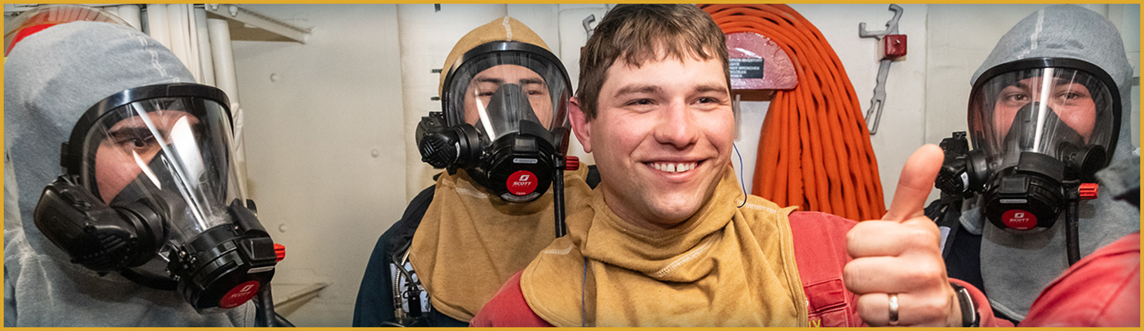
Motivation
Motivation is the drive to achieve goals for success.
Notes:
Facilitator Actions:
Display slide.
Discuss how graphic relates to topic.
Monitor the discussions of the Sailors.
Facilitator Content:
Inform:
Motivation involves using emotional energy to pursue goals with vigor and perseverance, enabling you to take initiative and persist through challenges.
EQ strengthens Warrior Toughness by fostering confidence, courage, and perseverance, keeping Sailors mission-focused in adversity.
This emotional adaptability is a key aspect of EQ, enabling Sailors to stay motivated without getting discouraged.
When motivation is lacking, commitment is the decision to stick with something even when you do not feel motivated.
EQ provides the skills and awareness necessary to form and sustain meaningful commitments.
Knowing your why can help individuals regulate negative emotions like fear or doubt, replacing them with a sense of motivation and reinforcing the first stage of the Warrior Mindset, commitment. When you know your why, the how doesn’t matter and this concept will increase toughness and resilience.
Knowing your why is also personal to you so it fuels intrinsic motivation. It is what moves you and keeps you going when you feel like you have nothing left to give.
Faith in purpose can help individuals regulate negative emotions like fear or doubt, replacing them with a sense of motivation and commitment to the goal. This fosters greater emotional resilience.
Faith can also fuel intrinsic motivation, allowing individuals to tap into a deeper well of emotional drive.
This sustained drive is necessary for achieving long-term goals and maintaining high performance, especially in high-pressure environments.
Discuss:
When you feel like quitting, what helps you push through?
How do you manage fear or doubt in challenging moments?

Slide 10

Empathy
Empathy is:
Understanding others’ emotional states
Considering their feelings in decisions
Responding to their emotions accordingly
Notes:
Facilitator Actions:
Display slide.
Discuss how graphic relates to topic.
Monitor the discussions of the Sailors.
Facilitator Content:
Inform:
Understanding oneself is necessary for empathy; you cannot read other people's emotions if you are not conscious of your own.
Ways to practice empathy:
Put yourself in someone else’s shoes.
Stay out of judgment and listen attentively.
Recognize emotions in another person that you have felt before.
Communicate that you recognize that emotion and reflect on what you heard.
Examples of empathetic communication:
I understand how frustrating that experience must have been.
I may not know exactly how you feel, but I am here to listen.
Yes, I hear what you are saying.
This must be really tough for you.
I can see that you are upset.
It must be hard for you.
This is a really challenging time for you.
From what you have said, it is clear why you would be angry about that.
Thank you for telling me this.
What has this been like for you?
How are you feeling about it?
Discuss:
What does empathy mean to you?
How can you tell when someone is upset, even if they don’t say anything?
What do you do when a teammate is having a hard time?

Slide 11
Empathetic Listening
What are some challenges we might face when trying to empathize with others, and how can we overcome them?
CLICK TO DOWNLOAD VIDEO
(DVIDS VIDEO)
Open in your browser to download from DVIDS
Notes:
Facilitator Actions:
Display slide.
Select Play or use the Enter key to view the video.
Use the ESC key to return to the smaller size.
Let Sailors know where they can locate references.
Monitor the discussions of the Sailors.
Facilitator Content:
Discuss:
What are some challenges we might face when trying to empathize with others, and how can we overcome them? (Answers may vary, but should include: Some challenges are feeling burned out or taking on others’ problems. To overcome challenges, you can learn to set limits, have self-empathy, and practice self-care.)

Slide 12
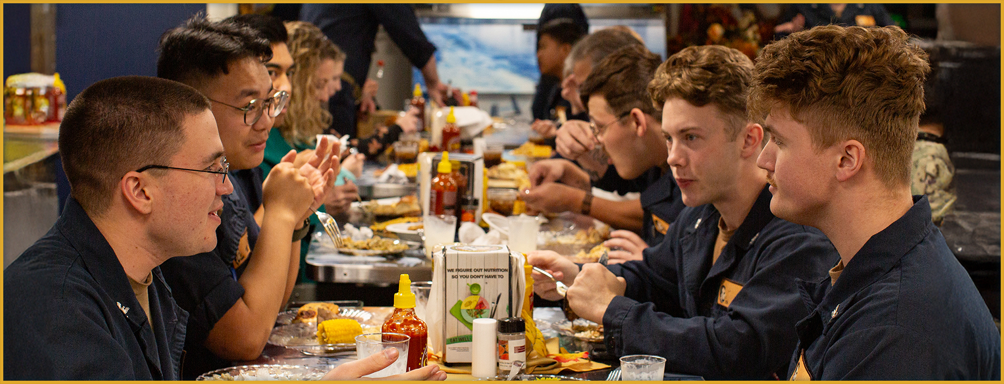
Social Skills
Notes:
Facilitator Actions:
Display slide.
Discuss how graphic relates to topic.
Monitor the discussions of the Sailors.
Facilitator Content:
Inform:
Social skills include network development, connection management, finding common ground, and developing rapport.
Emotional control and inspiring others are essential for effective collaboration and leadership.
The capacity to influence people and drive change is improved by having strong social skills.
Discuss:
What helps you build a good connection with someone?

Slide 13

Activity
Be attentive.
Request clarification if not understood well.
Look for emotional cues.
Pay attention to the verbal and non-verbal cues.
Sailors
Should
Show empathy toward the other person through their speech.
Ask open-ended questions.
Repeat what the other has just said.
Look for ways to find common ground with the other person.
Notes:
Facilitator Actions:
Display slide.
Monitor the discussions of the Sailors.
Allotted time for activity: 5 minutes
Expected outcome: Sailors will practice empathetic listening skills.
Facilitator Content:
Inform:
Ask Sailors to reflect on a situation that did not result in the way they expected or hoped it would (e.g., a time you didn’t perform as well as you wanted, a situation where you misunderstood someone or were misunderstood, a time you received unexpected feedback or criticism, a tough conversation).
Have Sailors form pairs to discuss this situation to practice using empathy and social skills.
Have them share what they are going through while their partner actively listens.
Then, have them reverse roles.
Discuss:
Were there any moments in the conversation when you felt particularly connected to the other person? What caused that connection?
What challenges did you encounter while trying to practice empathy in the conversation?
Inform:
Remind Sailors that during this activity, they should:
Be attentive.
Look for emotional cues.
Ask open-ended questions.
Repeat what the other has just said.
Request clarification if not understood well.
Pay attention to the verbal and non-verbal cues.
Show empathy toward the other person through their speech.
Look for ways to find common ground with the other person.

Slide 14
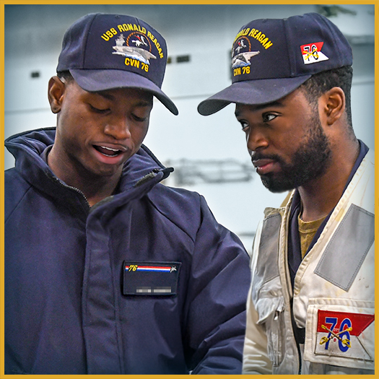
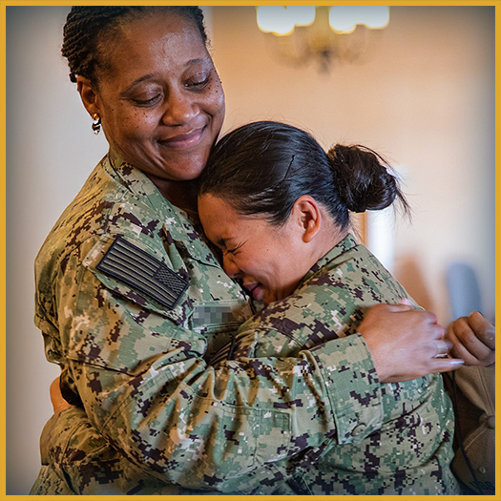

Role of EQ
What are some examples of emotionally intelligent behavior?
Emotionally intelligent individuals are aware of their own and others' emotions.
Notes:
Facilitator Actions:
Display slide.
Discuss how graphics relate to topic.
Monitor the discussions of the Sailors.
Facilitator Content:
Inform:
EQ shapes how emotions are experienced, expressed, and influence behavior and relationships. It guides actions, adapts to situations, and promotes well-being through emotional regulation, social engagement, stress management, and conflict resolution.
High EQ helps individuals and leaders stay composed under pressure, fostering resilience, quick conflict resolution, and a healthy team environment.
A focus on EQ supports constructive processing of failure and continuous self-improvement.
Faith in oneself enhances self-confidence, which improves decision-making, leadership, and emotional regulation.
Cultivating a spirit of growth encourages individuals to stay open to learning and to stay emotionally balanced in the face of feedback or failure.
It also improves teamwork, communication, and leadership, as leaders with high EQ inspire trust and support.
Faith in others fosters trust and collaboration, enhancing interpersonal relationships and communication within teams.
Discuss:
What are some of the benefits of having high EQ as a person, as a member of a team, and as a leader?
Can someone share an experience they had with someone you would consider having high EQ?

Slide 15
Improve EQ
Why is it important to improve EQ?
Self-Awareness
Self-Regulation
Motivation
Empathy and Social Skills
Practicing Mindfulness
Journaling
Seeking feedback from others
Pausing before reacting
Practicing breathing techniques
Using cognitive reframing
Setting meaningful goals
Visualizing success
Active listening
Perspective taking
Conflict resolution
Collaboration
Notes:
Facilitator Actions:
Display slide.
Monitor the discussions of the Sailors.
Facilitator Content:
Inform:
EQ can be improved by:
Practicing Mindfulness to improve self-awareness
Journaling to process emotions and reflect on experiences
Exercising regularly to enhance mood and reduce stress
Seeking feedback from peers on emotional responses and leadership style
Listening attentively, focusing on both verbal and non-verbal cues
Recognizing stress indicators and responding appropriately
Using emotional regulation techniques to stay grounded
Balancing work and well-being by taking breaks, seeking mental health support, and using coping strategies
Discuss:
Why is it important to improve EQ? (Answer: Improving EQ is critical because it enhances your ability to effectively manage emotions, build resilience, and perform optimally under pressure.)

Slide 16

Call to Action
Master your emotions and understand others to build a stronger, more cohesive team!
Notes:
Facilitator Actions:
Display slide.
Review topics discussed and ask if there are any questions.
Check Sailor comprehension by providing review questions and/or problems.
Discuss how the call to action supports and encourages Sailors’ post training.
Relate call to action to Warrior Toughness.
Facilitator Content: N/A

Slide 17
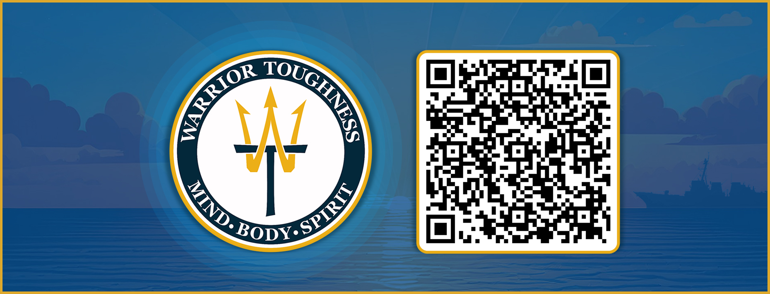
Warrior Toughness QR Code
Notes:
Facilitator Actions:
Display slide.
Facilitator Content:
Inform:
Identify Warrior Toughness QR code.

Slide 18
References
Tools and Resources
Mental Health Playbook
WT Placemat
WT Playbook
Notes:
Facilitator Actions:
Display slide.
Facilitator Content:
Inform:
Identify tools.
Identify resources.

Slide 19
Glossary
Glossary
Acronym | Term
EQ | Emotional Intelligence
WT | Warrior Toughness
Notes:
Facilitator Actions:
Display slide.
Facilitator Content: N/A

